Slide 1
Mobile Social Digital Tools
To kick up your content strategy

Slide 2
“Things are going to get weird”
Amy Webb, Future Today Institute

Slide 3
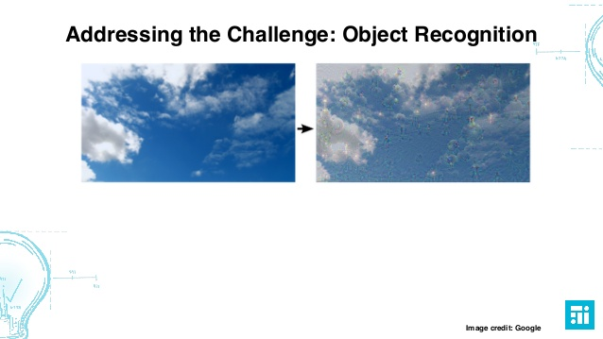
Object recognition
Machines have vision
Notes:
http://www.slideshare.net/webbmedia/tech-trends-for-journalists-9th-annual-online-news-association-presentation

Slide 4
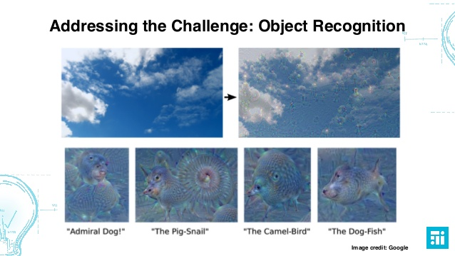
Object recognition
What do they see?
Google Deep Mind - Differential Neural Computer, AI
Notes:
http://www.slideshare.net/webbmedia/tech-trends-for-journalists-9th-annual-online-news-association-presentation
Google’s Deep Mind neural network http://thenextweb.com/artificial-intelligence/2016/10/17/deepmind-ai-platform-can-now-learn-without-human-input/

Slide 5

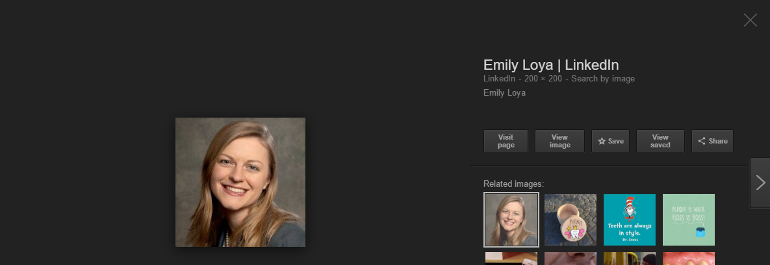

Google “Emily Loya Teeth”
Google Deep Mind - Differential Neural Computer, AI
Notes:
http://www.slideshare.net/webbmedia/tech-trends-for-journalists-9th-annual-online-news-association-presentation
Google’s Deep Mind neural network http://thenextweb.com/artificial-intelligence/2016/10/17/deepmind-ai-platform-can-now-learn-without-human-input/

Slide 6
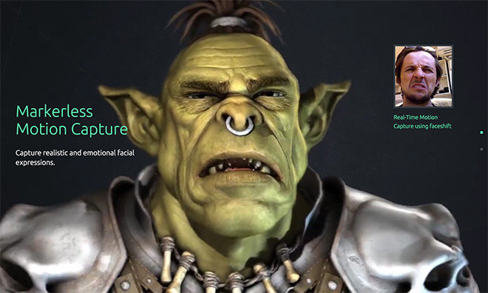
Motion Recognition
Notes:
http://www.slideshare.net/webbmedia/tech-trends-for-journalists-9th-annual-online-news-association-presentation
Google’s Deep Mind neural network http://thenextweb.com/artificial-intelligence/2016/10/17/deepmind-ai-platform-can-now-learn-without-human-input/

Slide 7
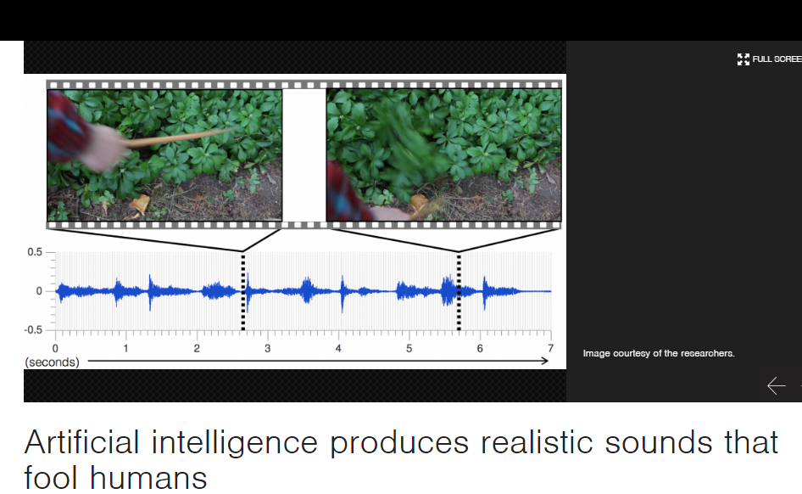
Sound Recognition
Notes:
http://news.mit.edu/2016/artificial-intelligence-produces-realistic-sounds-0613

Slide 8
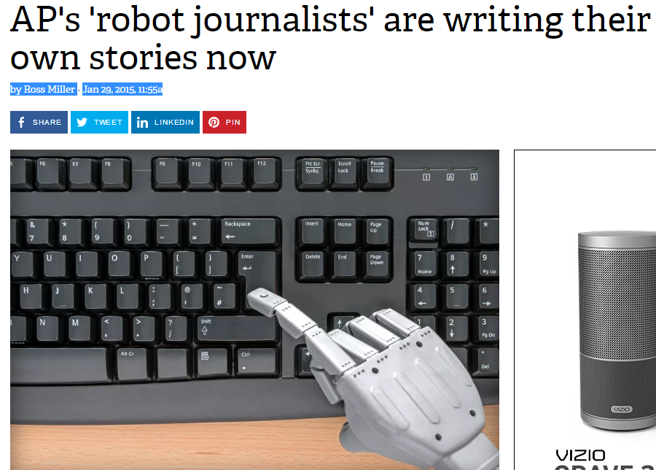
Computer-generated news stories, newsletters
Automated Insights, Narrative Science
Earnings reports
Fantasy football reports
Earthquake alerts (sensor data)
Notes:
http://www.theverge.com/2015/1/29/7939067/ap-journalism-automation-robots-financial-reporting

Slide 9
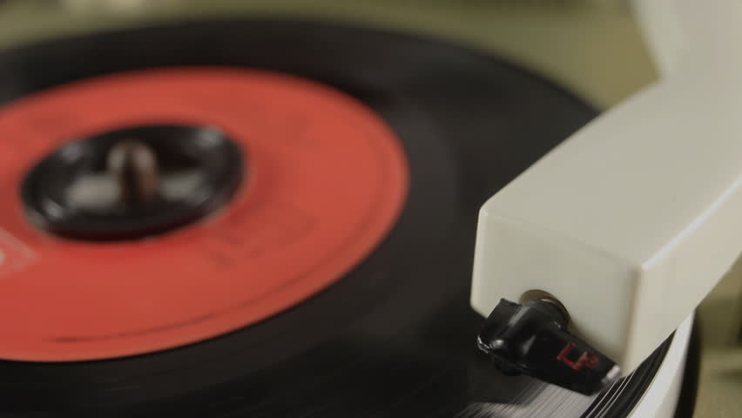
Near future: Computer-generated video stories
Notes:
http://www.theverge.com/2015/1/29/7939067/ap-journalism-automation-robots-financial-reporting

Slide 10
Meanwhile, right now

Slide 11
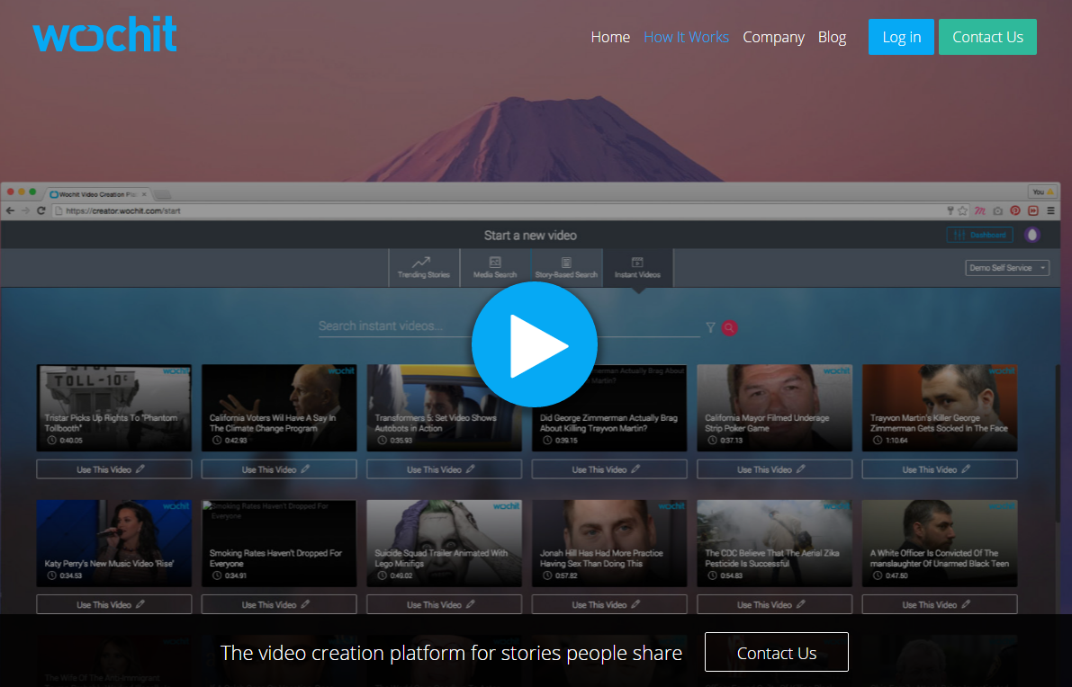
Wochit - 3 free to start
Analyzes text of an article and automatically finds licensed photos, videos and graphics
Publishers can quickly edit the video and add things like background music and voiceover.
Notes:
https://www.wochit.com/how-it-works/

Slide 12
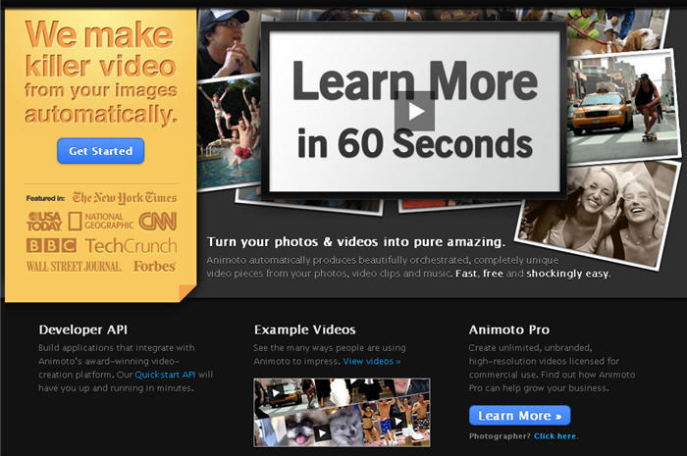
Animoto
Both free and paid versions. Pricing plans range from $8 a month for personal use to $34 a month for businesses.
Upload images
Music catalog
Notes:
https://www.wochit.com/how-it-works/

Slide 13

Video boom
Will be seeing more and more fast video production options
Within 12 - 36 months Different version for every platform
At full burn, 50-60 videos a day
Amy Webb
Notes:
https://www.wochit.com/how-it-works/

Slide 14
Apps

Slide 15
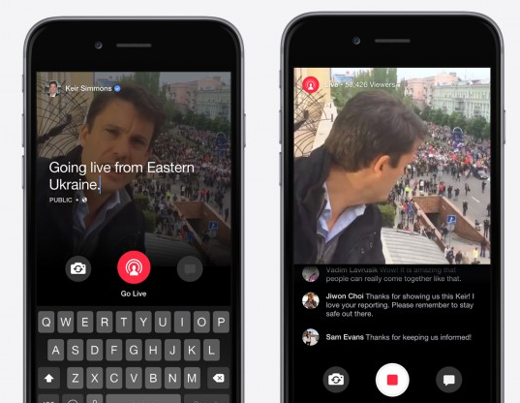
Livestreaming
Periscope
Facebook Signal
Ustream
Stringwire - Users enable live video for NBCUniversal news.
Google Hangouts On Air/YouTube
Meerkat
Bambuser
Blab (RIP 2015-2016)
Notes:
https://ijnet.org/en/blog/five-live-streaming-tools-journalists

Slide 16
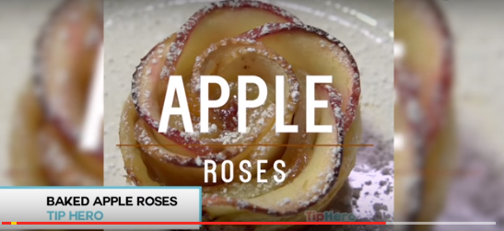
Viral video
CREATE
Instagram
Vine
DISTRIBUTE
YouTube Capture
Instagram
Facebook
TRACK TRENDS
YouTube charts
PopScreen
Notes:
https://www.youtube.com/watch?v=_Dirf_QHDCw

Slide 17
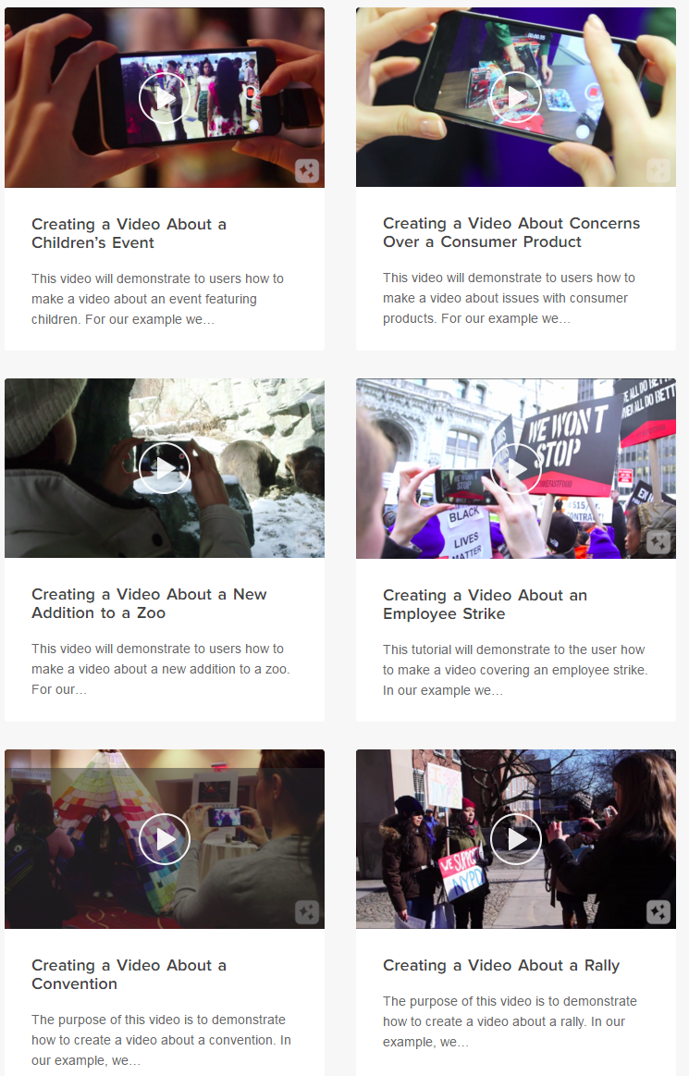

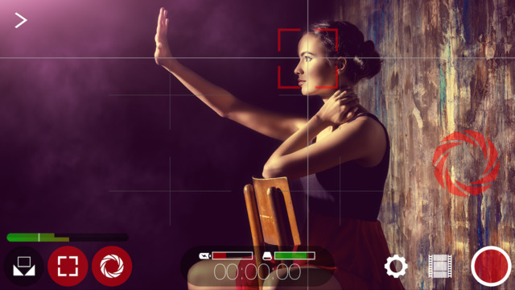
Video Recording
Filmic Pro - $9.99
Videolicious - Free and Enterprise
Storyline by Arcivr - $1.99 Audio slideshows

Slide 18
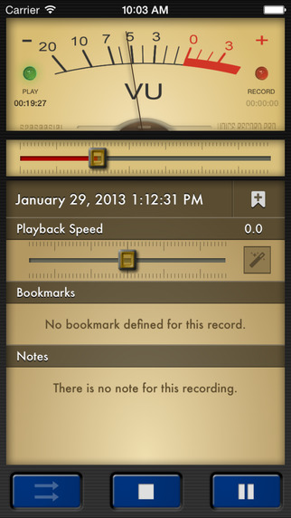
Audio Recording
Ferrite - Multitrack recording and editing. Free version limited to 1 hour recording, 10 min product.
Audio Memos (iphone) - Recording
VC Audio Pro – $6.99 Multi-track editing capability, a sound mixer, clip arranger and a volume curve, on-the-go sound editing.
REPORT-IT Live – $29.99. Radio, TV Reporters & Journalists – Broadcast HD quality audio from your iPhone live to air. 15kHz HD quality audio
Voice Record Pro - Track levels as you record (Free)
Notes:
http://www.kenneymyers.com/blog/10-iphone-apps-for-recording-editing-audio/

Slide 19
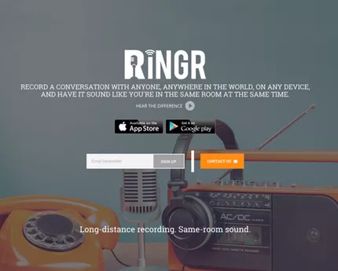
Audio Recording
Ringr - Designed for podcasting
Anchor - Audio blogging. Free. 2-minute audio “waves” - snackable content
TapeACall- $9.99. Record outgoing and incoming calls. (Sets up a 3-way call).
Notes:
http://www.kenneymyers.com/blog/10-iphone-apps-for-recording-editing-audio/

Slide 20
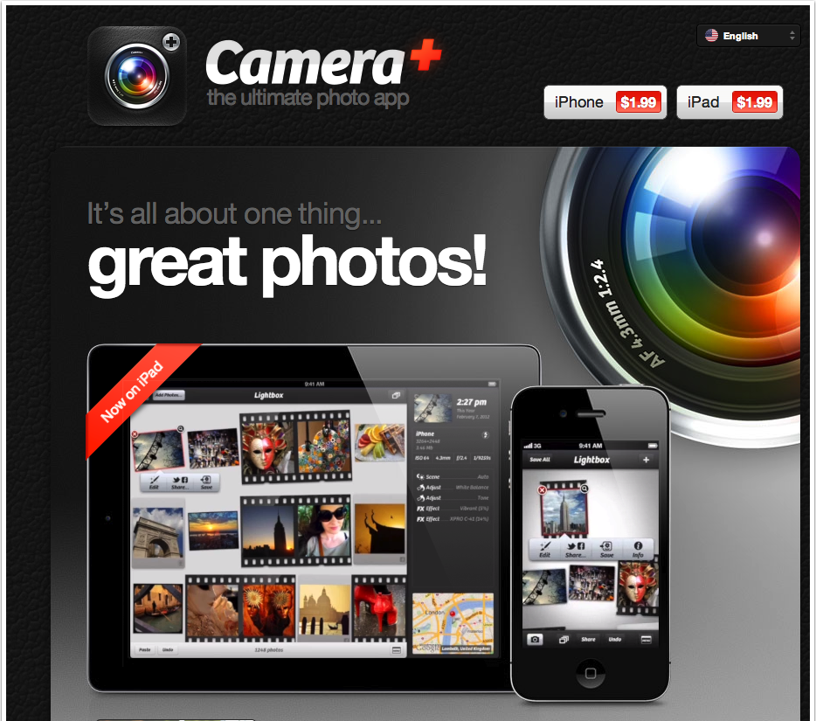
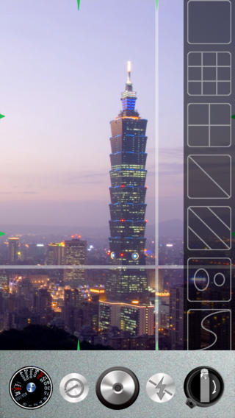
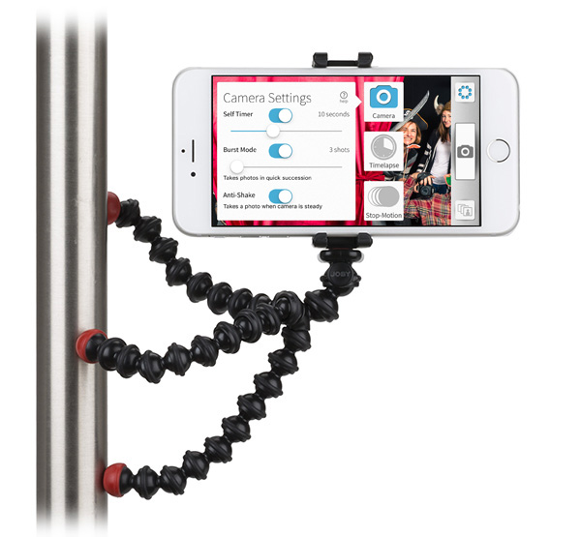
Photography
Camera + - Extra features
Cinema FV-5 Lite - Android
Gorilla Cam - Stop motion; time lapse; timer
Adjust Grid - variety of composition modes

Slide 21
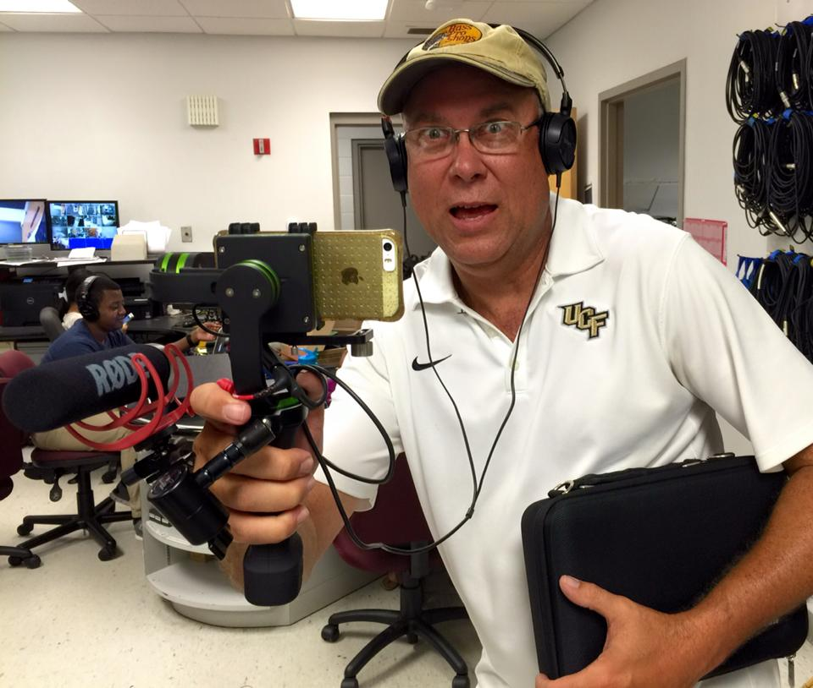
Gear
Lenses
Mic
Stabilizer (steady cam)
earphones
Transmission
Rick Brunson, Nicholson School of Communication

Slide 22
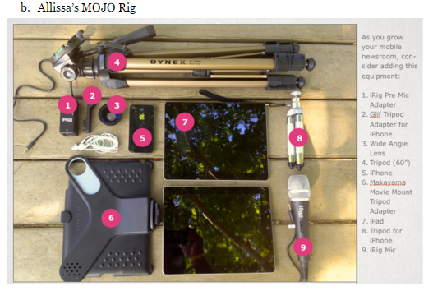
Advanced Gear
Specialty lenses
iRig Pre Mic adapter
iRig Mic
More tripods

Slide 23
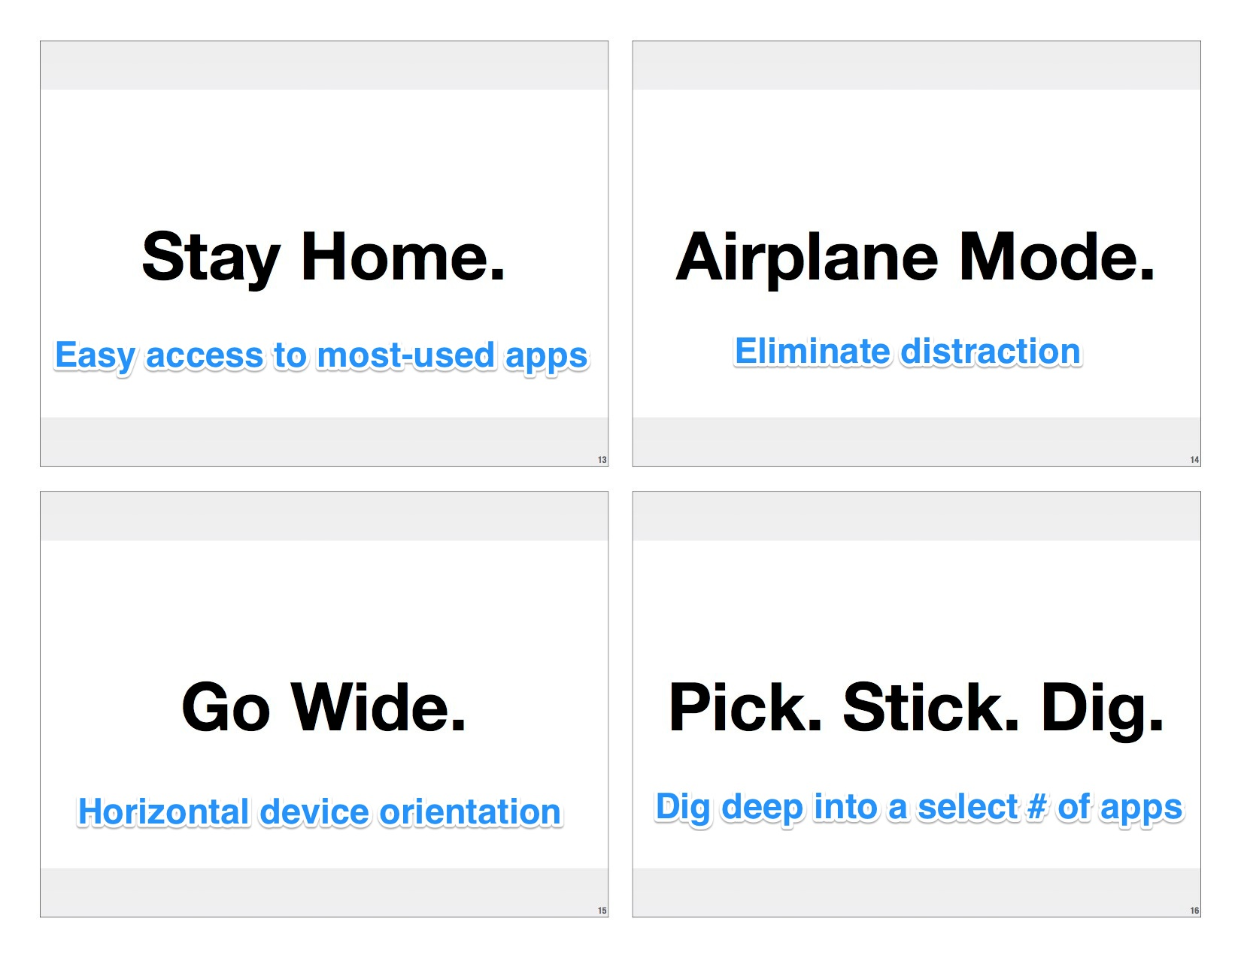
In The Field
Airplane mode
Horizontal video
Mobile Field Guide: http://multimediashooter.com/mobile/MobileGuide.pdf
Notes:
http://multimediashooter.com/mobile/MobileGuide.pdf

Slide 24
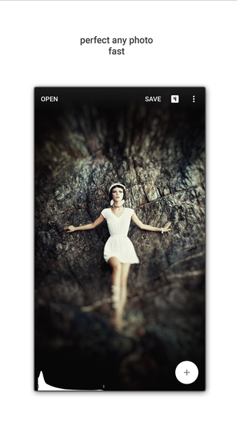
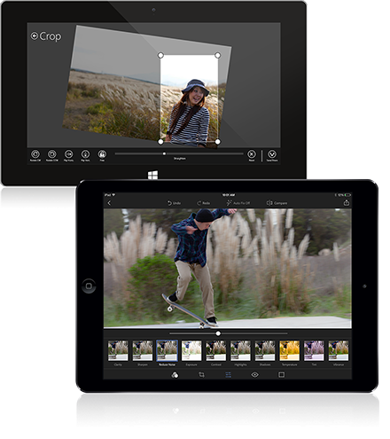
Editing
Crop on the Fly
Photoshop Express
Adobe Voice (audio & animation)
Imovie
Snapseed (free)

Slide 25
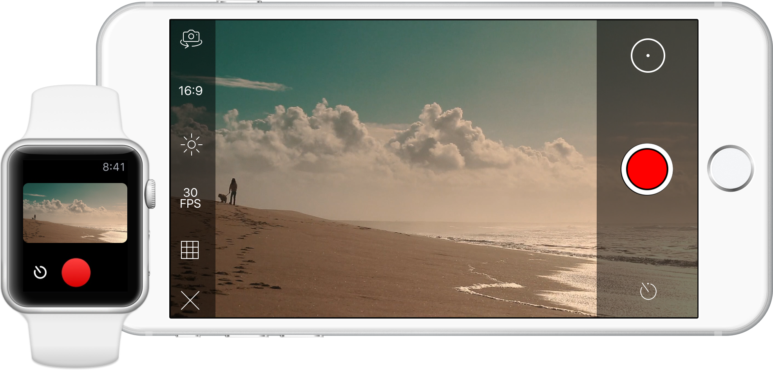
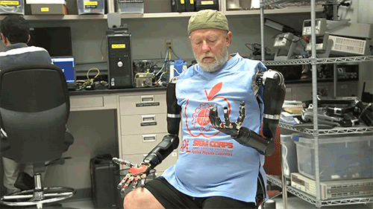
GIFs / Cinemagraphs
GIPHY - Make, find, share gifs
Flixel - make moving photos
Echograph
Animoto (text, music slideshow - Monthly fee)
Photoshop
Search for the latest

Slide 26
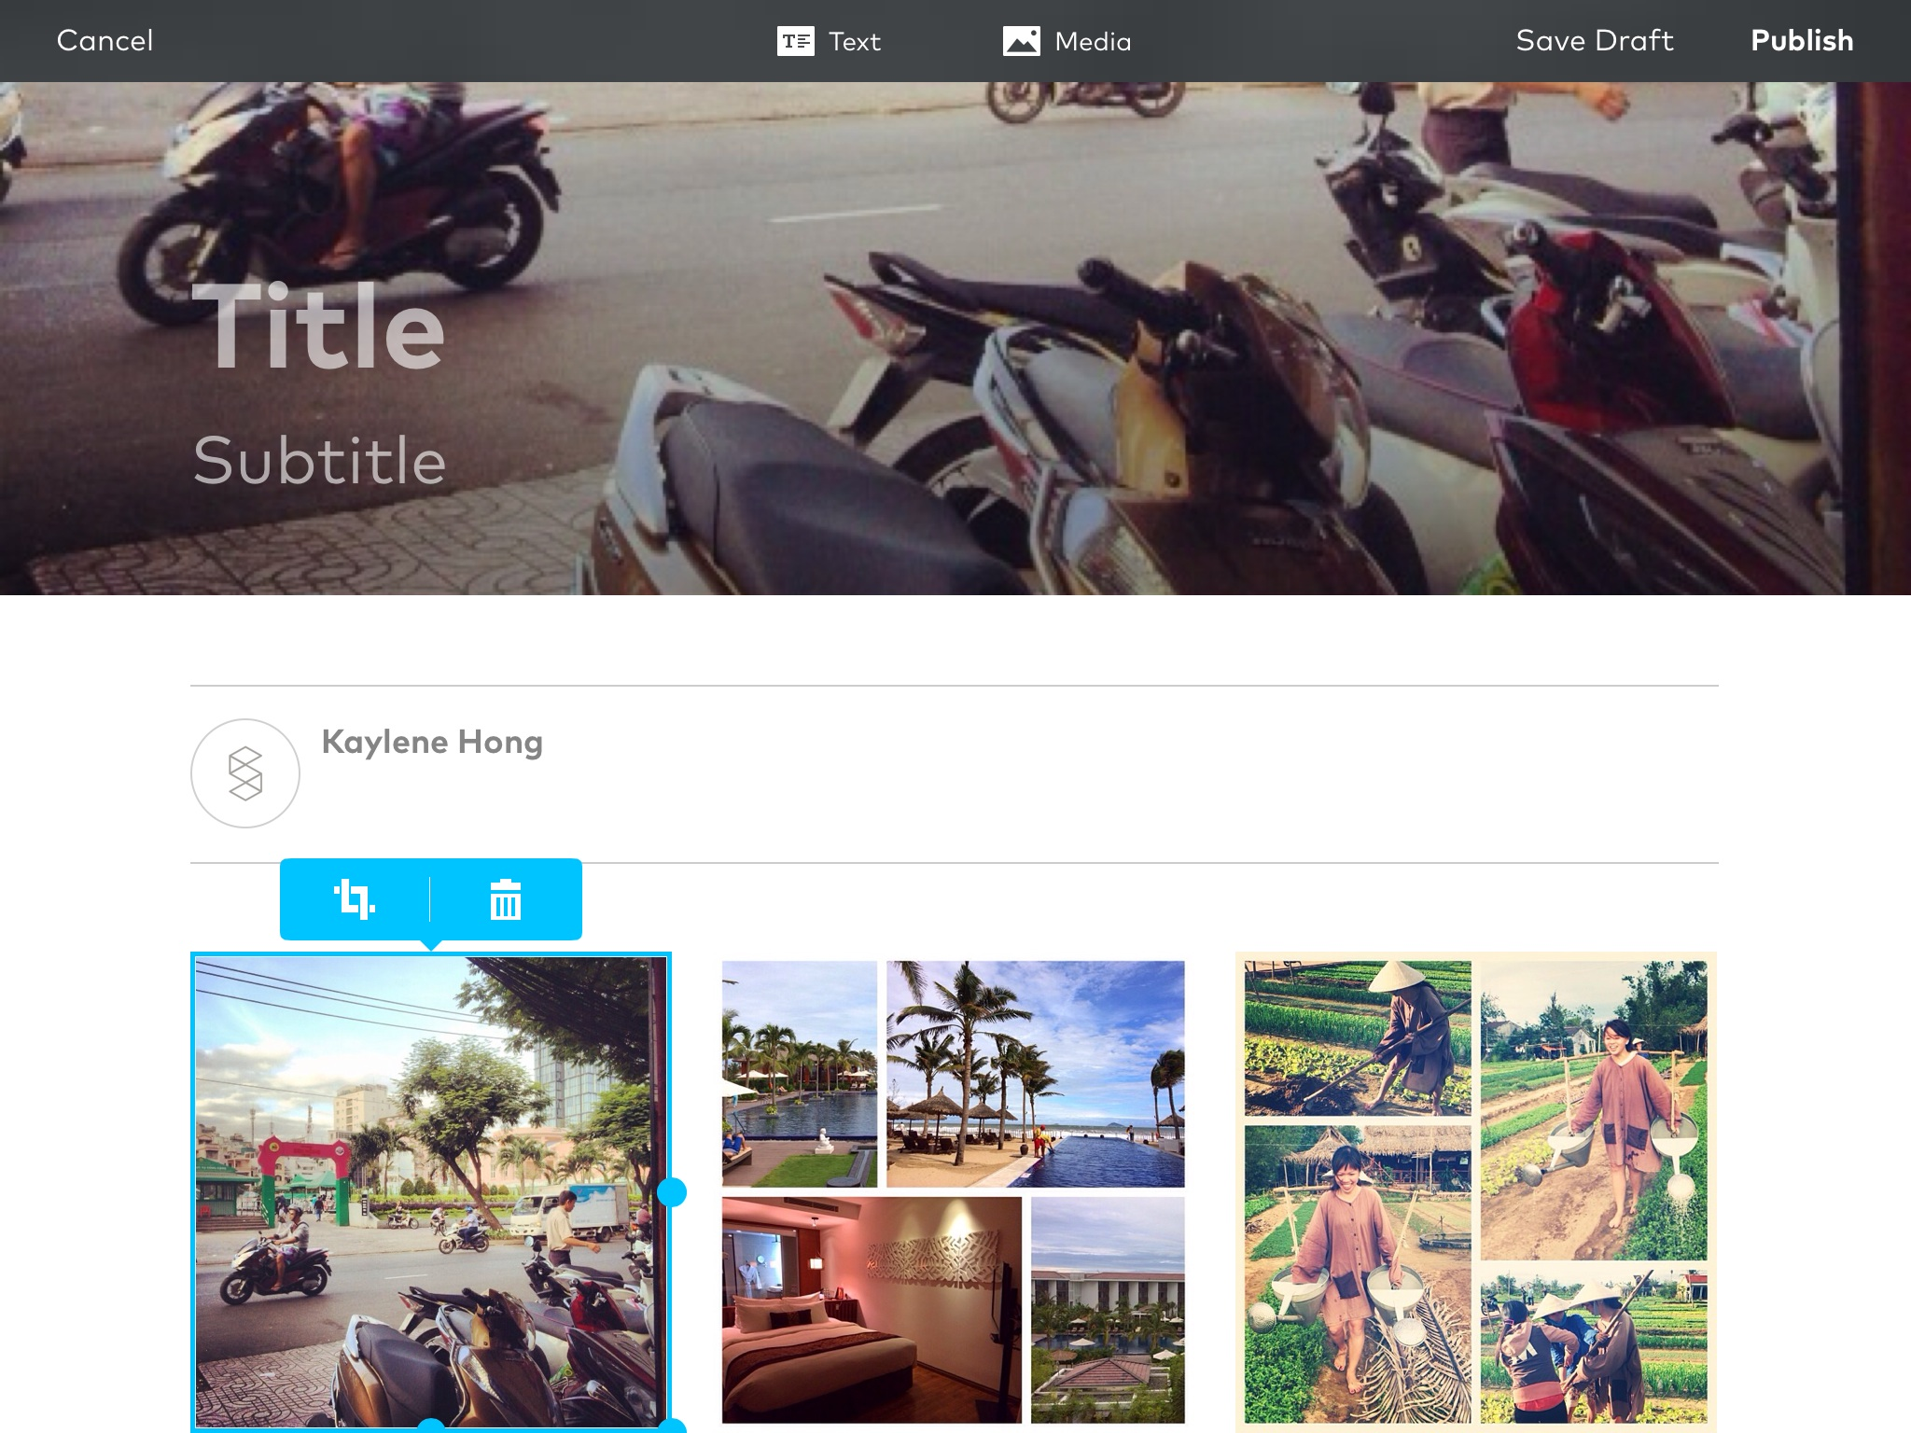
Presentation
Storehouse - App for sharing beautiful photo stories
Quickly lay out and publish photos, videos and text
The stories are entirely public and readable through the app.

Slide 27

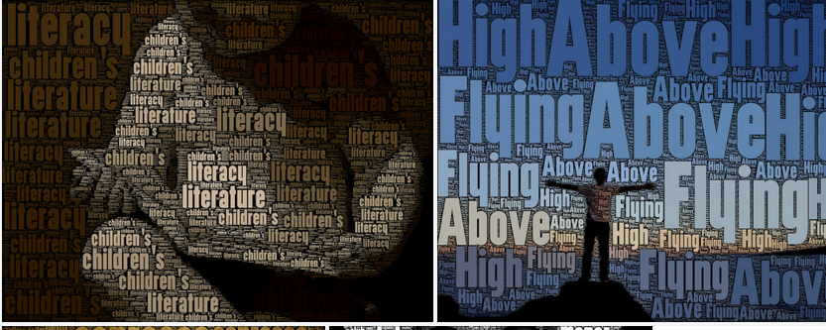
Photo Illustration
Over - Add text & art to photos
Buffer Pablo
Wordfoto

Slide 28
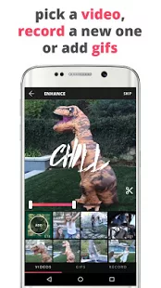
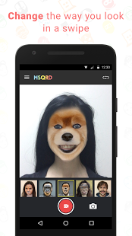
Novelty
Ditty - Singing messages
MSQRD - Filters for selfies

Slide 29
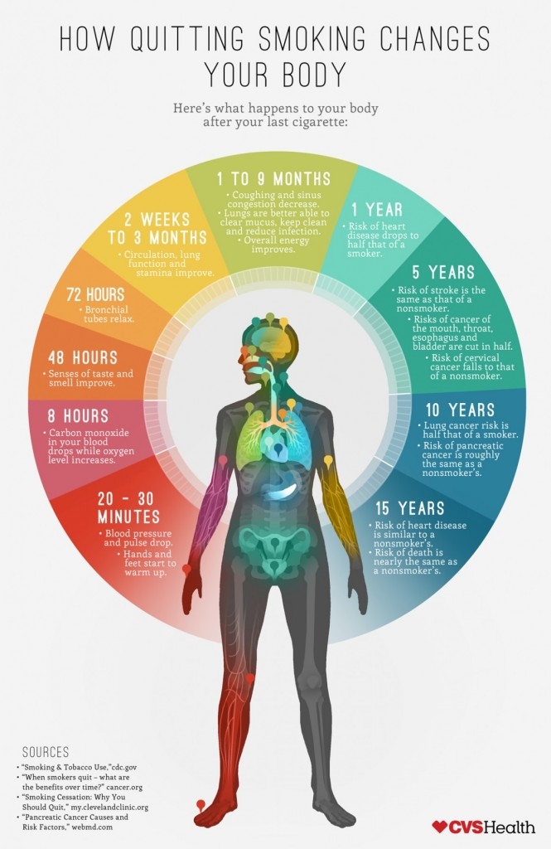
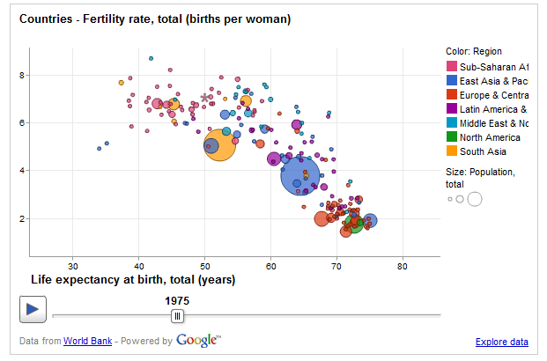
Infographics
PiktoChart
Infogr.am
Vanngage
Visual.ly
Easel.ly
Google public data explorer
Hohli
iCharts
Canva

Slide 30

Mixed reality
Hologram
Augmented Reality (digital overlays)
Virtual Reality (immersive)
360 (multidirectional camera angles)
Notes:
https://ijnet.org/en/blog/five-live-streaming-tools-journalists

Slide 31
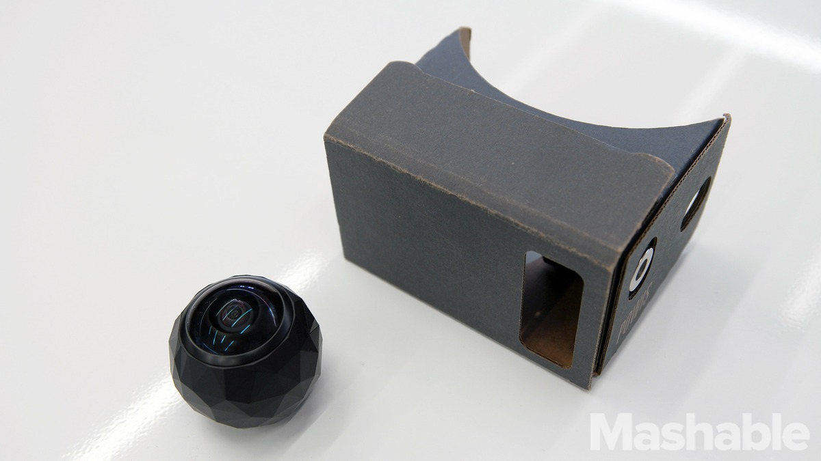
Virtual Reality
360Fly camera $399
Vrse - viewing
YouTube
Google Cardboard

Slide 32
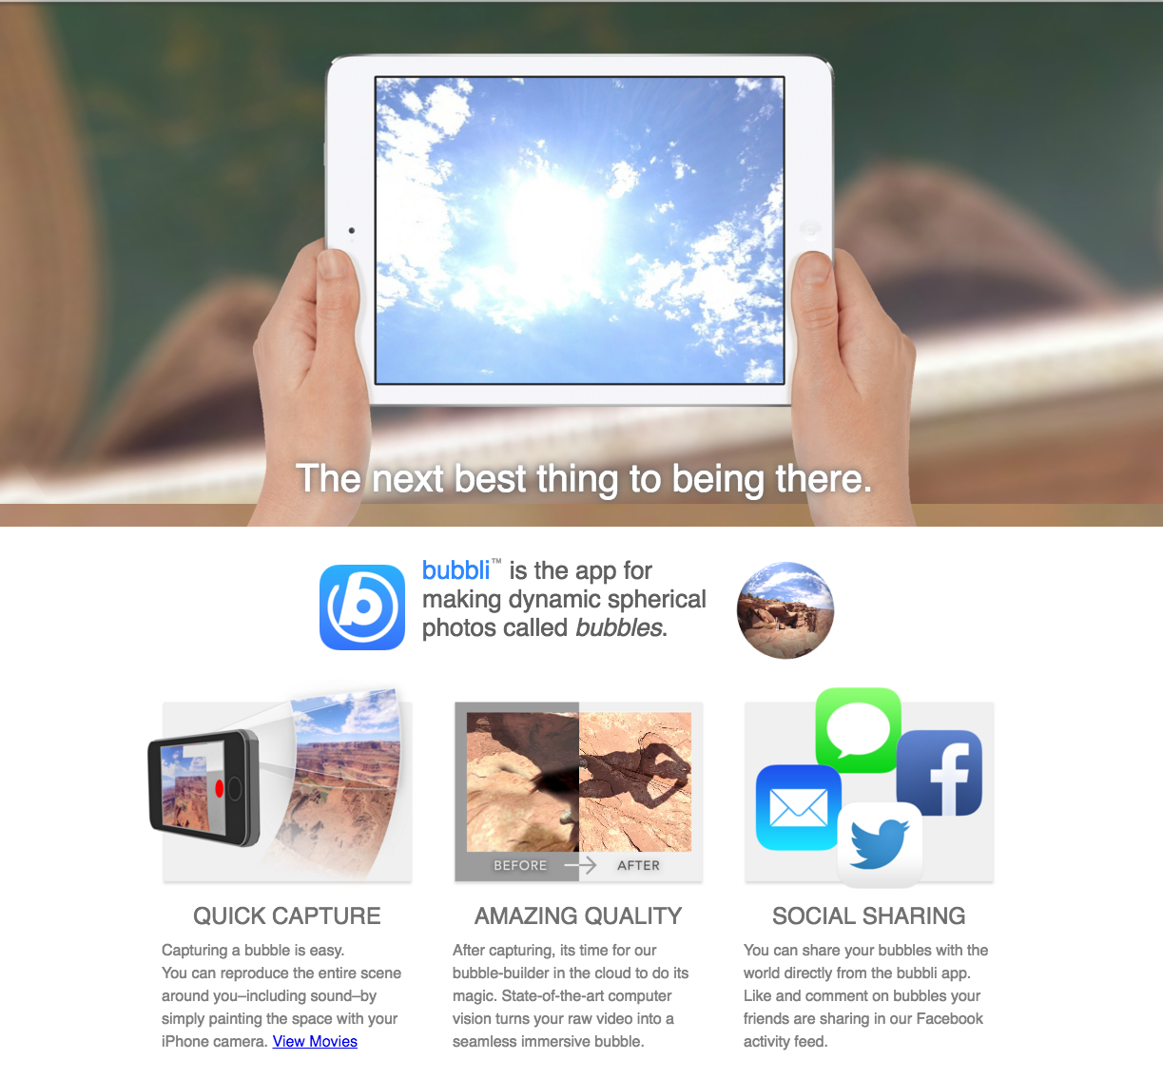
360
Bubb.li
Panorama or Surround Shot mode or by using Street View
Google Camera and Cardboard Camera on Android to share a 360 photo on Facebook

Slide 33
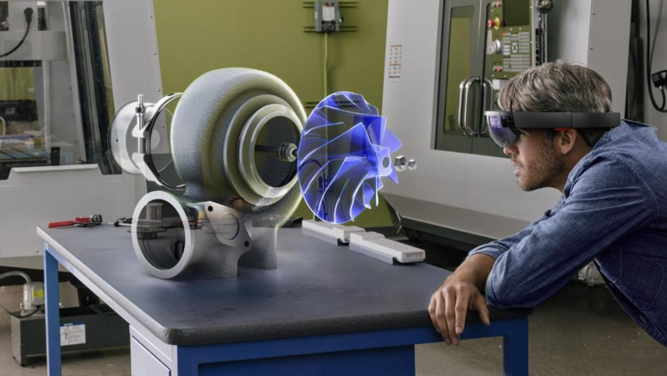
Augmented Reality
Microsoft Hololens $3,000
Magic Leap (someday)

Slide 34

Mixed reality
Use Mixed Reality to tell stories that are better experienced than passively watched
Keep it short (more than 5 mins uncomfortable)
First consider:
“Simulation sickness”
Requires undivided attention
Does your audience have time?
Notes:
http://www.mbryonic.com/best-vr/

Slide 35
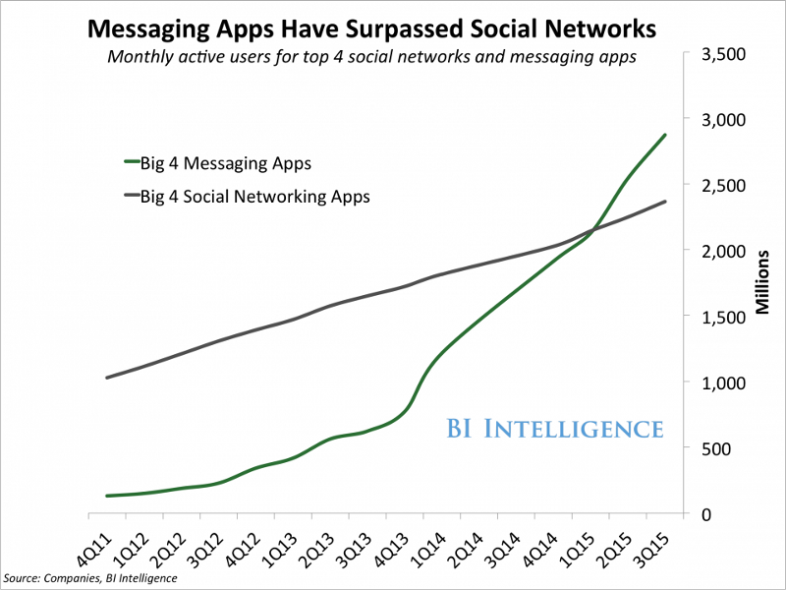
Messaging apps
Facebook messenger
WhatsApp
Slack
Kik
Yik Yak
Notes:
https://chatbotsmagazine.com/the-complete-beginner-s-guide-to-chatbots-8280b7b906ca#.fy4qweu3o
https://chatbotsmagazine.com/have-15-minutes-create-your-own-facebook-messenger-bot-481a7db54892#.xju15blbo

Slide 36
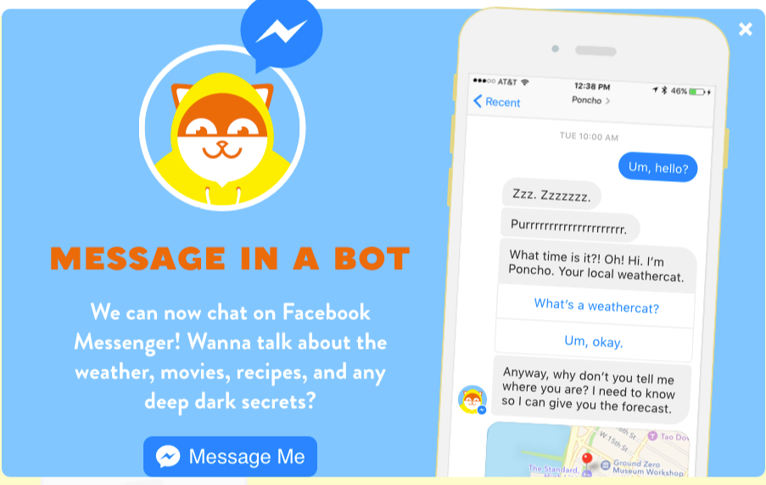
Chat bots … Messenger bots
Notes:
https://chatbotsmagazine.com/the-complete-beginner-s-guide-to-chatbots-8280b7b906ca#.fy4qweu3o

Slide 37
Audience Engagement

Slide 38
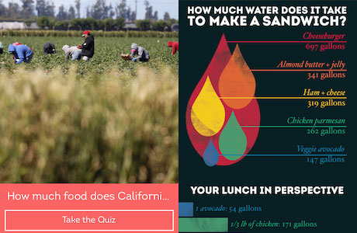
Engagement
Instagram
Snapchat
Twitter
Facebook
Storify
Card stacks (explainers) - Fold from MIT
Notes:
https://www.journalism.co.uk/news/distributed-news-the-vox-way-of-getting-stories-out-to-6-social-platforms/s2/a603974/
https://www.journalism.co.uk/news/how-vox-aj-and-fold-are-using-cards-for-storytelling-/s2/a565471/

Slide 39
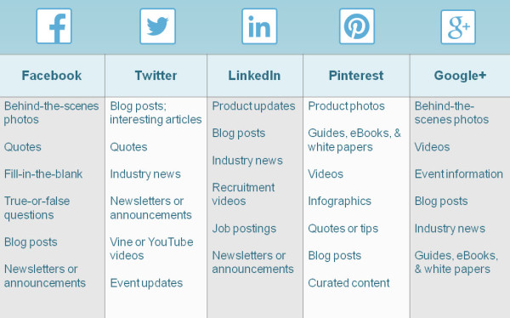
Social Media Engagement Ideas
Polls / Surveys
  SurveyMonkey
  PollDaddy
Quizzes
  Apester
  Qzzr
#Scavenger hunt
Infographics
Facebook game apps
  Shortstack
SMS - Push notification
  PushWoosh
Interactive Maps / Data
  Google maps
  Tableau
  Mapme

Slide 40
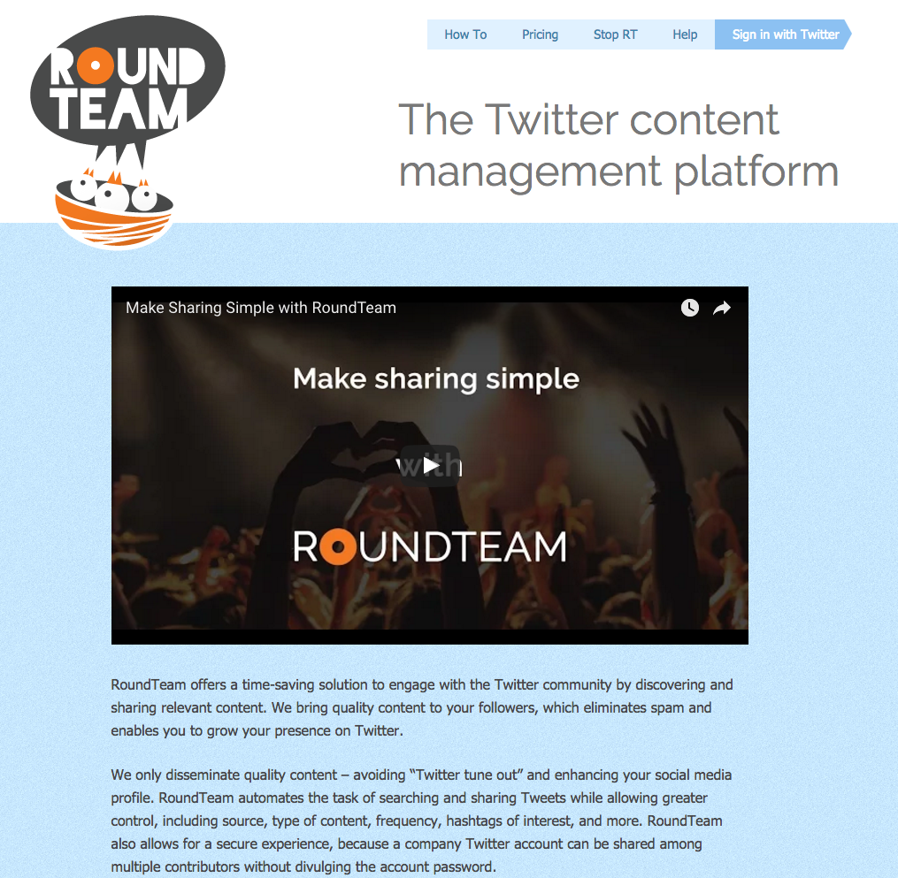
Social Media Sharing
Roundteam
  Retweet group members
  Retweet hashtags

Slide 41
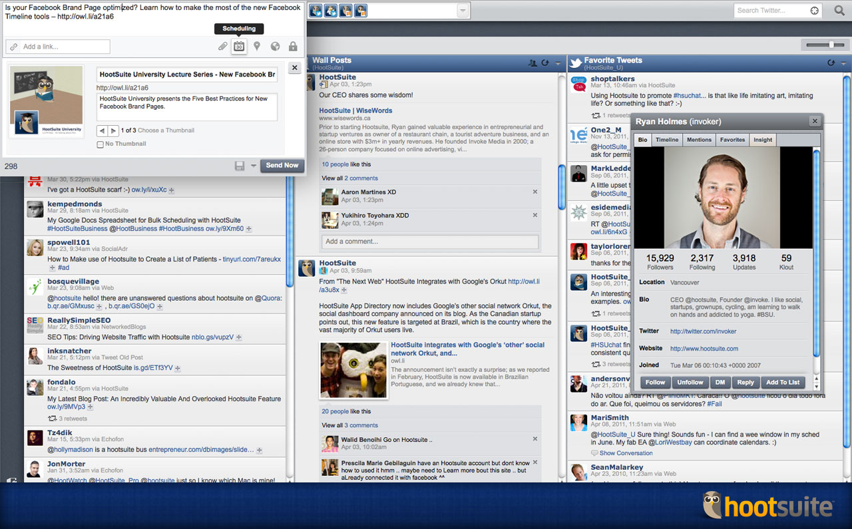
Social Media Management
Hootsuite
Tweetdeck
Buffer

Slide 42

Social Media Measurement
Keyhole
Notes:
http://www.keyhole.co/

Slide 43
Productivity, Planning

Slide 44

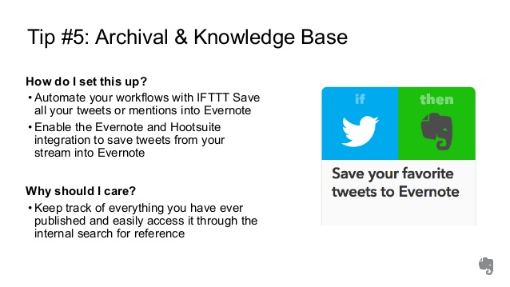
Productivity Tools
Evernote
RSS reader (Feedly)
Pocket
Google Drive
Dropbox
IF (formerly If This, Then That)
Otranscribe (website)
Google Doc dictation
AP Stylebook app

Slide 45
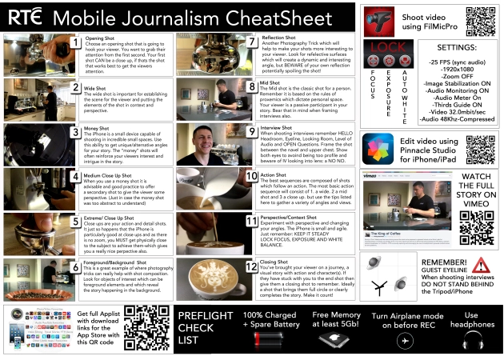
The Ultimate Mojo CheatSheet (2014)
Sequences Deconstructed, examples, apps – everything you need (except the gear)
Notes:
https://tvvj.wordpress.com/2014/07/14/the-ultimate-mojo-cheatsheet-sequences-deconstructed-examples-apps-everything-you-need-except-the-gear/

Slide 46
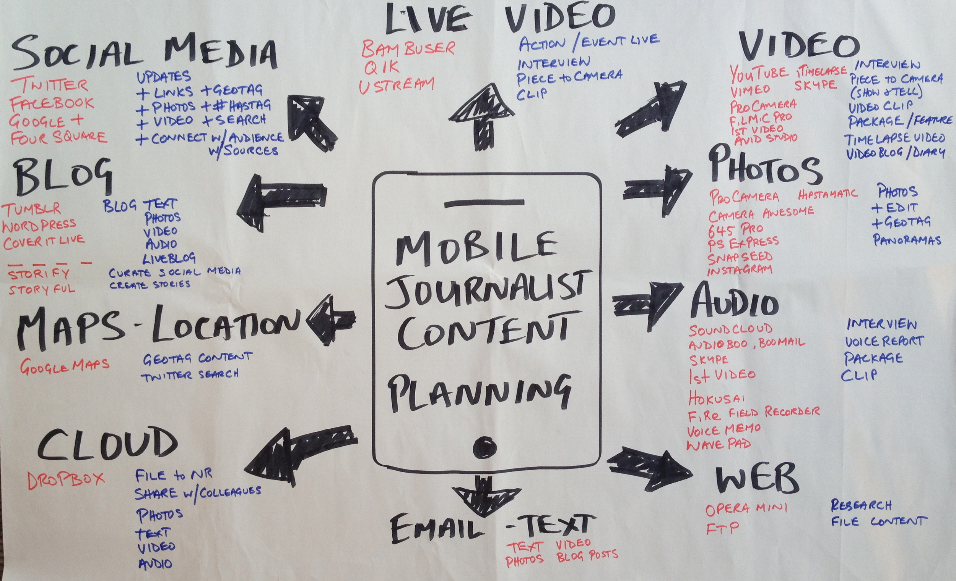
More
Than
Apps
OnMedia: Training Mobile Journalism
Notes:
http://onmedia.dw-akademie.com/english/?p=4649
Apps - http://www.robbmontgomery.com/p/mojo.html

Slide 47
Web / blog plugins
Tools to help display content on your web page

Slide 48
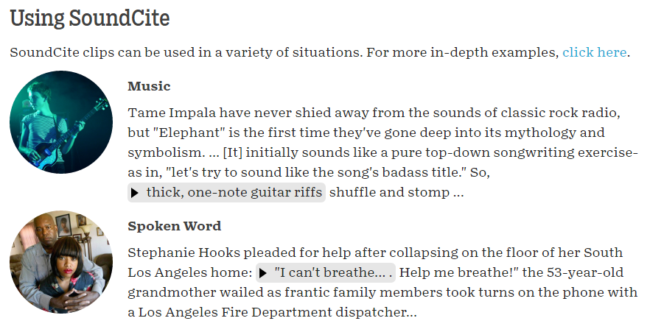
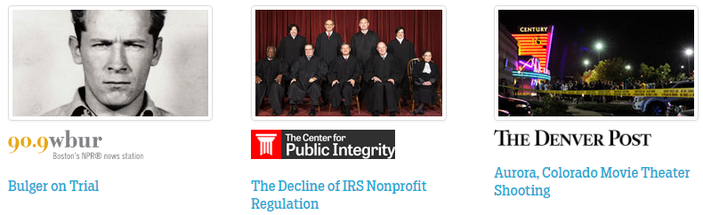
Digital Storytelling
Soundcite
  Inline embedding of sound files
Storymap
  Free tool to tell stories that highlight the locations of a series of events
Timelinejs
  Open-source, visually rich, interactive timelines
Notes:
https://soundcite.knightlab.com/
https://storymap.knightlab.com/

